Slide 1
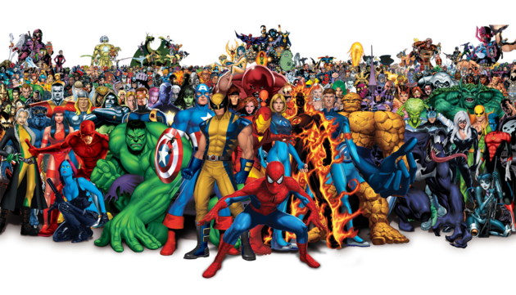
Marvel Mythos – Team 3
Erik Catchings
Nathan Gutierrez
Alex Martinez
Steven Paniagua
Carlie Smith
Shatyana Thomas
Justin VanHaven
Presentation Date: 1/19/2022

Slide 2
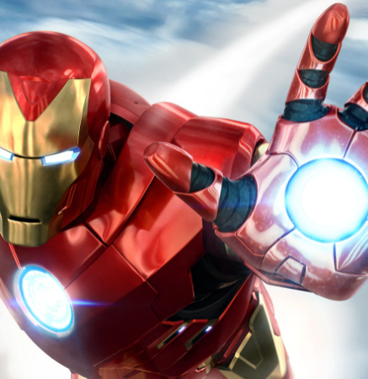
You NEED Marvel Mythos!
Marvel Mythos is a one-stop site to see and learn more about any character in the Marvel universe. With a single click, you’ll receive the history, backstory and amazing trivia about YOUR favorite character.
Concept: simple, single return of information
User Story: As a comic book fan, I want a one-stop site so I can learn more about my favorite Marvel characters.

Slide 3
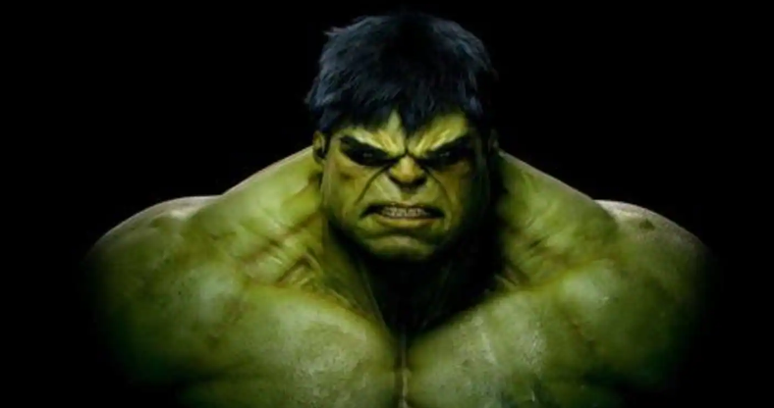





Project details:
Project assignment
Project concept developed. Wireframing completed.
We built our baseline HTML, CSS and script. Connection to both selected APIs confirmed. Wireframing completed.
Styling and development
Bulma.io is an easy CSS with simple, clean styling. jQuery was used for much of the script tasking
Initial design and connectivity
Refinement for MVP
MVP delivery
For MVP we elected to use character selection instead of an open search.
Our site is ready for use with future enhancements.

Slide 4
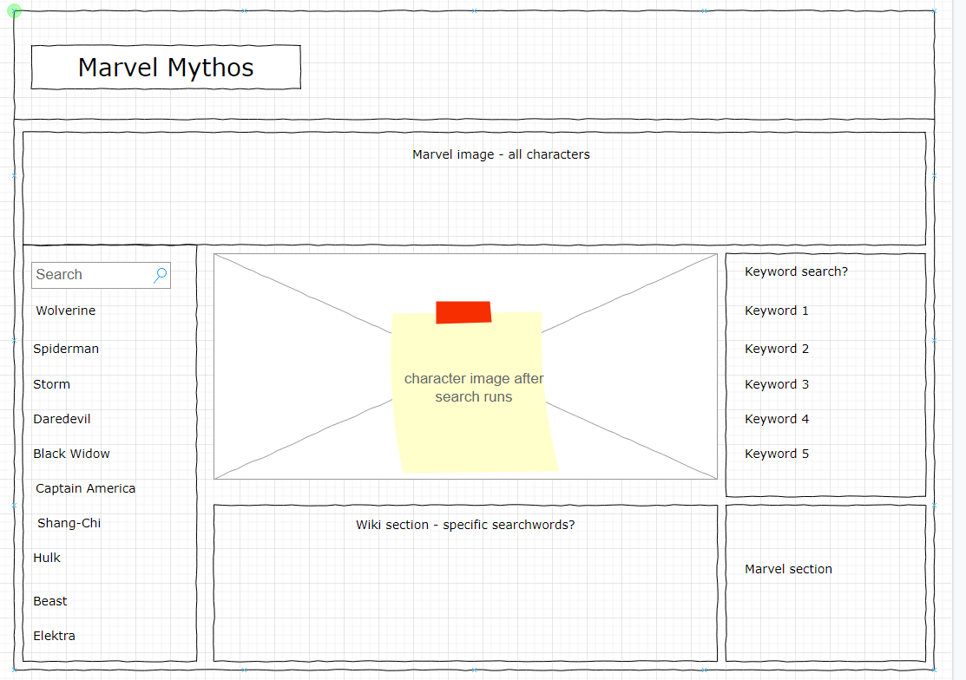
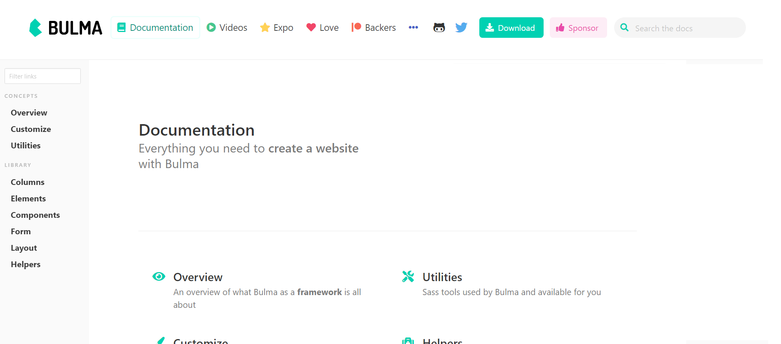
Project Elements

Slide 5
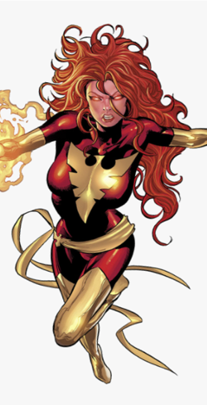

Process & demo
Tasks & Roles
Design: Nathan
Team member availability, scope creep, GitHub
Successes
Early API connection, project theme enthusiasm, adapting to Bulma.io
Challenges
Site Deployment
Future Iterations
https://github.com/cjsmith011/Marvel-Mythos.
Open character search, refinement of search keywords
https://cjsmith011.github.io/Marvel-Mythos/
Code: Justin, Alejandro
Coordination: Carlie

